Slide 1

Advanced
Web Graphics
source:https://www.w3schools.com

Slide 2
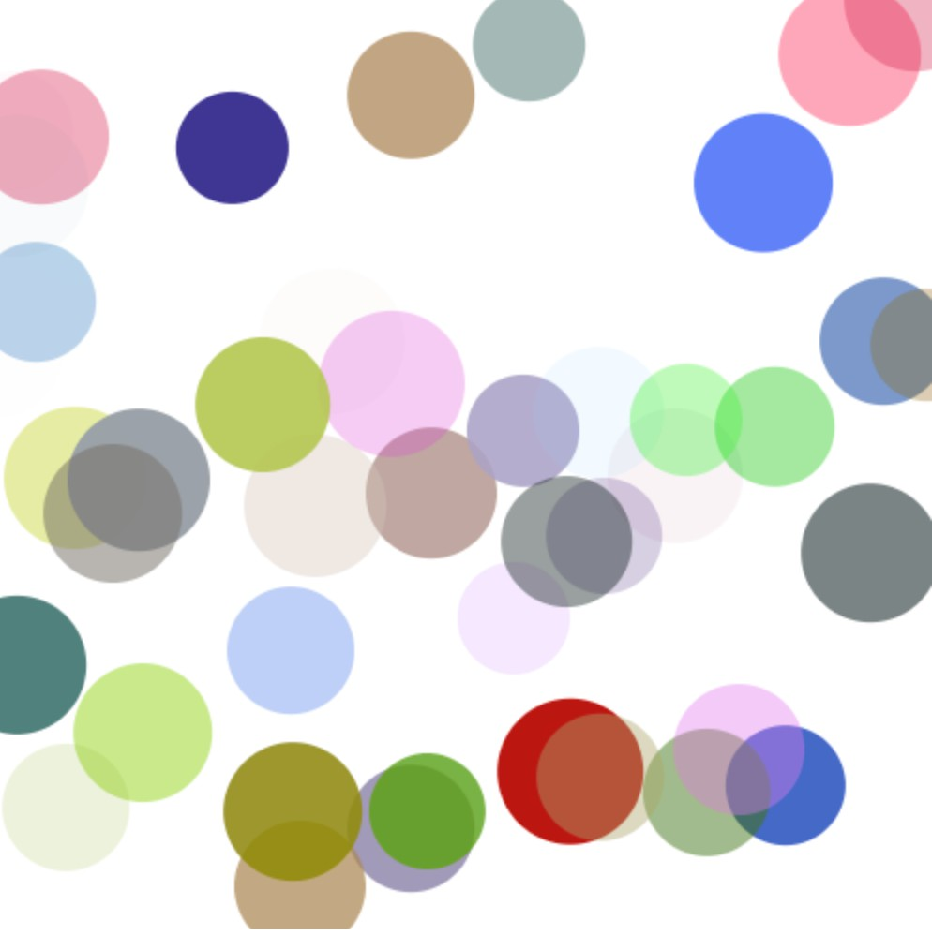
Bouncing Ball using Class

Slide 3
<body>
<canvas id="myCanvas" width="500" height="500"></canvas>
<script>
//見下頁
</script>
</body>
給予500X500的畫布

Slide 4
class Ball {
constructor(x,y,r,color){ this.x=x;
this.y=y; this.r = r;
this.color = color;
this.dx = random(-3,3)+0.001; this.dy = random(-3,3)+0.001;
}
draw(g){ g.beginPath();
g.arc(this.x,this.y,this.r,0,Math.PI*2); g.fillStyle=this.color;
g.fill();
}
move(){
this.x = this.x + this.dx;
if (this.x > width || this.x < 0 ) {
this.dx = -this.dx; this.x = this.x + this.dx;
}
this.y = this.y + this.dy;
if (this.y > height || this.y < 0) {
this.dy = -this.dy; this.y = this.y + this.dy;
}
}
}
設定球的x,y位置，半徑(r)，與顏色(color), 與球的水平(dx)垂直(dy)移動量
想想看，為什麼要有正負設計？
球的繪製，由球的x,y位置，半徑，與顏色決定球的外觀
計算球的移動，當碰到畫布(canvas)邊緣時，球會反彈，進行反向運動(dx -> -dx, dy -> -dy)

Slide 5
var canvas = document.getElementById("myCanvas");
var ctx = canvas.getContext("2d");
var width = canvas.width;
var height = canvas.height;
function random(min,max)
{
return Math.random()*(max-min)+min;
}
var balls=[];
for( i = 0; i < 50; i++)
{
x=random(0,width); y=random(0,height);
r = 30 + random(0,10);
color="rgba("+random(0,255)+","+random(0,255)+','+random(0,255)+","+Math.random()+")";
balls.push(new Ball(x,y,r,color));
}
render();
隨機產生球的位置(0~width, 0~height)與半徑(30+0~10)
產生隨機RGBA顏色，範圍從暗到亮(0～255)
從balls陣列尾端新增一棵球(Ball元素)
將所有球(balls)畫在畫布裡，是一個recursive function, 會不斷的呼叫自己而達成動畫影格的繪製

Slide 6
function render(){
ctx.clearRect(0,0, width, height);
for (i =0; i< balls.length;i++) {
balls[i].draw(ctx);
balls[i].move();
}
window.requestAnimationFrame(render);
}
清除上一影格的畫面，避免畫面殘留的問題
將每一個球畫出，並進行下一步的移動
約1/60秒後會呼叫render，進行下一個畫面的繪製，而形成動畫

Slide 7
LAB：
1.增加球的數量
2.增加球與球之間的大小差異
3.讓球碰觸到邊線即反彈

Slide 8

EventListener
element.addEventListener(event, function);
mouseout
mouseover click
事件
<button id="myBtn">Try it</button>
<script>
document.getElementById("myBtn").addEventListener("click", myFunction);
function myFunction() {
alert ("Hello World!");
}
</script>
addEventListener可以監控事件(click, mouseout…)，若發生可以執行myFunction()

Slide 9
Keyboard events
key events
  keydown
  keyup
<button id="myBtn">Try it</button>
<script>
document.getElementById("myBtn").addEventListener("keydown", myFunction);
function myFunction() {
alert ("Hello World!");
}
</script>

Slide 10
2D
Transformation

Slide 11

Outlines
Geometric Transformation
Linear Transformation Standard Basic Transformation Composite Transformation Homogenous

Slide 12
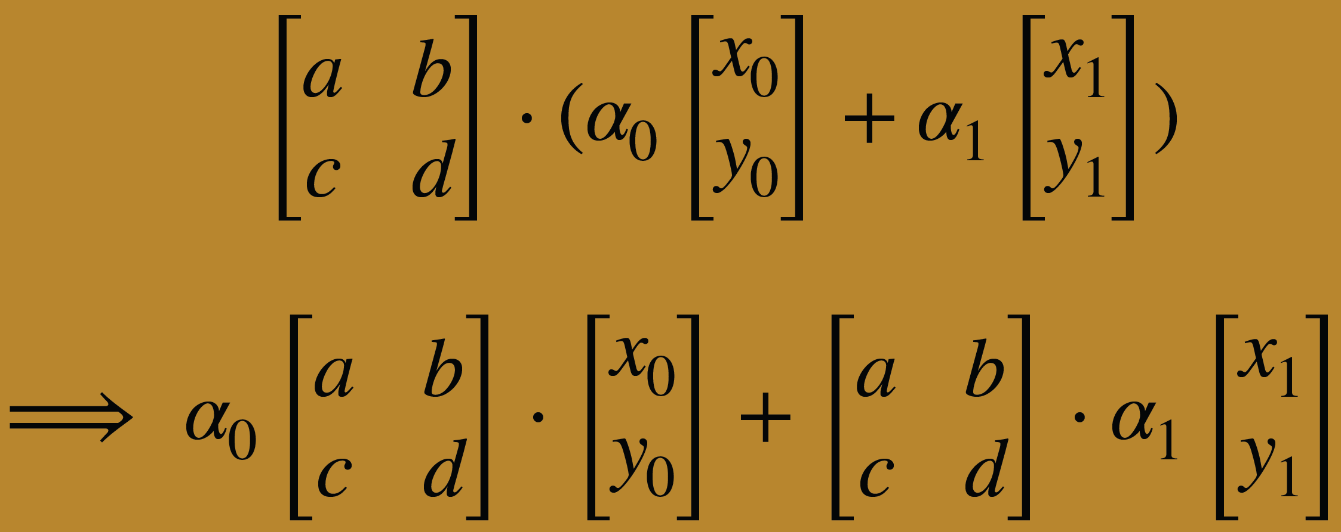
Linear Transformation
T(α₀ ⋅ u₀ + … + α_{k} ⋅ u_{k}) = α₀ ⋅ T(u₀) + … + α_{k} ⋅ T(u_{k})
where α₀…α_{k} are scalars
and u₀…u_{k} are vectors of our space

Slide 13

2D Geometric Transformation
Translation Rotation, Scaling, Sheer

Slide 14
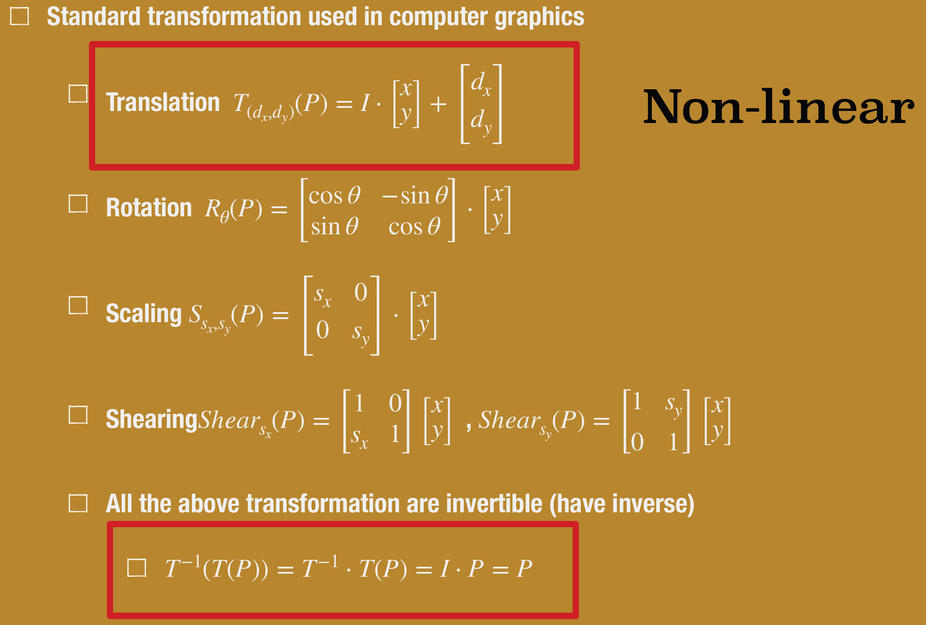
2D transformation as Matrix

Slide 15
Transformation Linearity
Basic standard transformation such as
  scale,
  rotate,
  and shear
  are linear transformation

Slide 16
Composite Transformation
Composite transformation used in computer graphics
T₁(T₂(…T_{n}(P)))
Translation cannot be expressed as a linear transformation and is therefore impossible to express it as a matrix multiplication.
Need to extend 2D coordinate to 3D homogenous coordinate

Slide 17

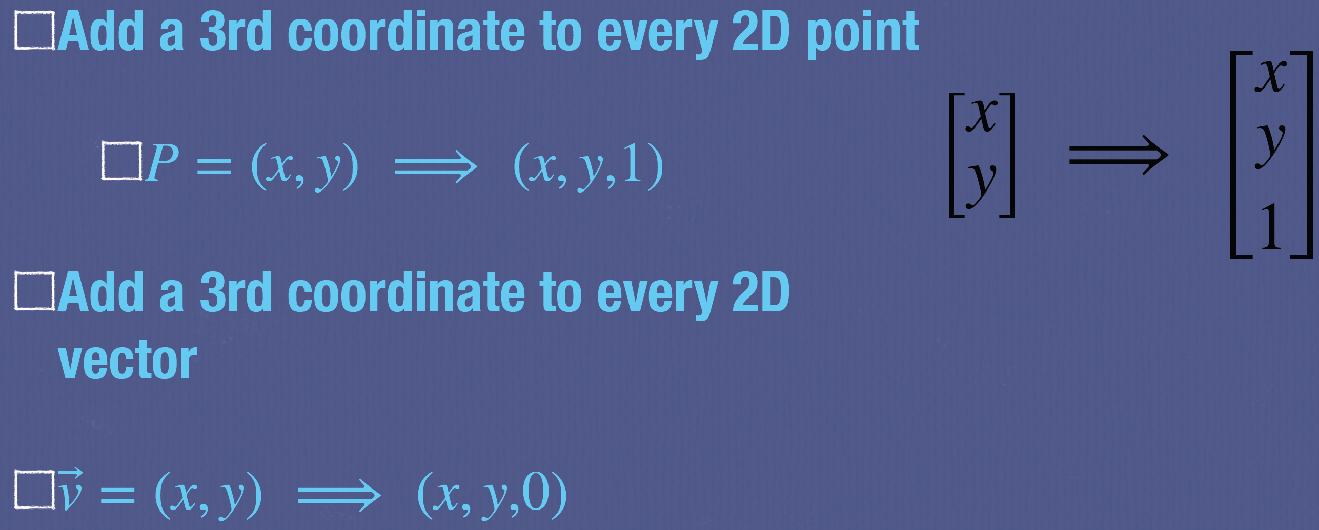
Homogeneous Coordinate
Represent coordinate in 2D dimension with 3-vector
(x, y) ⟹ (x, y, w)

Slide 18

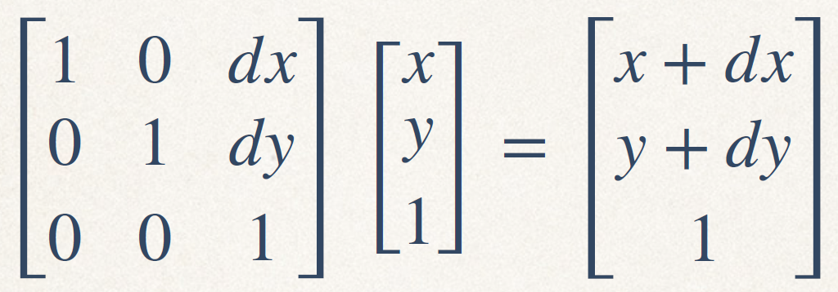


Translation(dx,dy)
(0,0)
x
(dx,dy)
Y

Slide 19
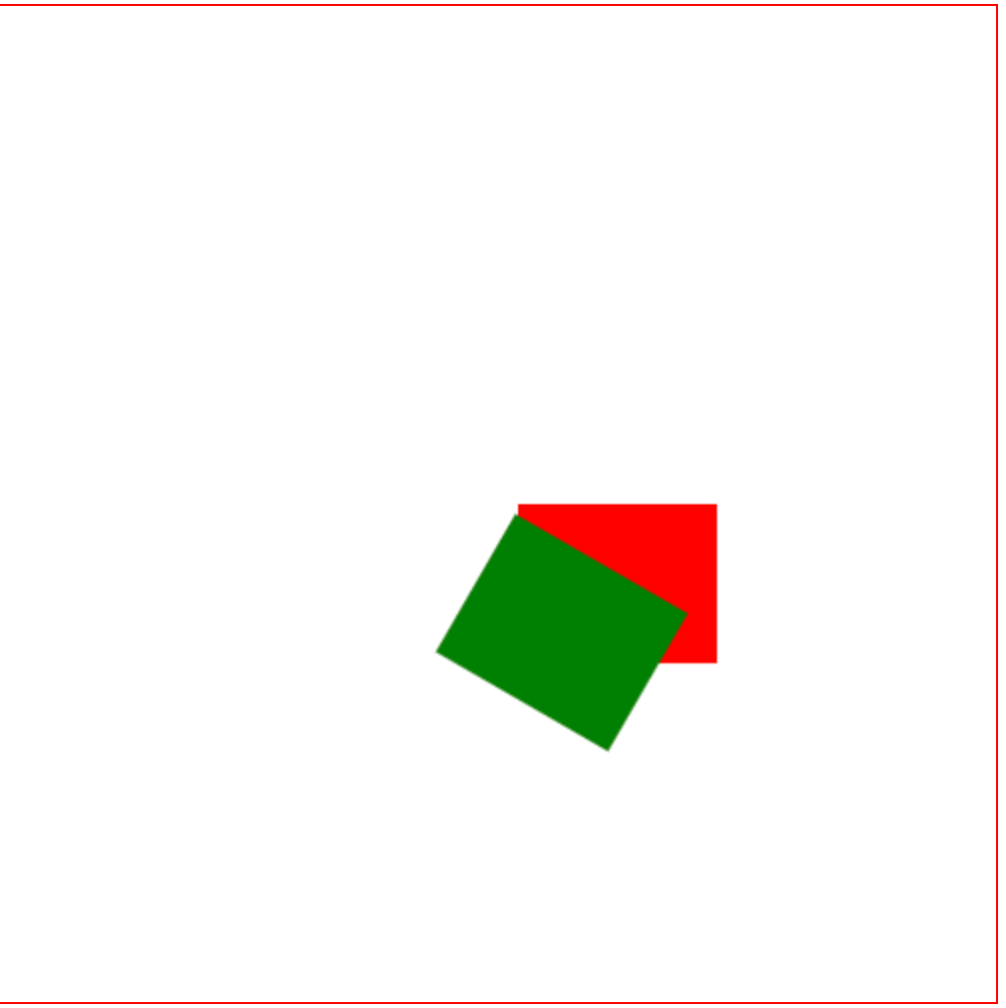
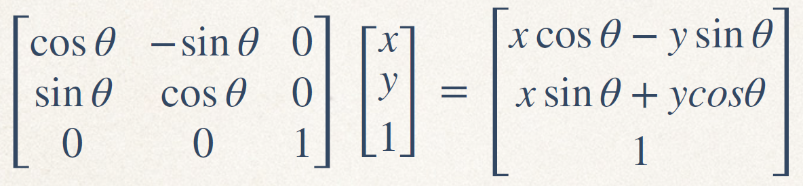
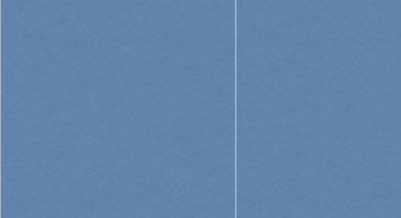
Rotation()
(0,0)
x
<canvas id="myCanvas" width="500" height="500"></canvas>
<script>
canvas = document.getElementById("myCanvas");
g = canvas.getContext("2d");
g.translate(100,100);
g.fillStyle="red";
g.fillRect(0,0,100,80);
g.rotate(Math.PI/6);
g.fillStyle="green";
g.fillRect(0,0,100,80);
</script>
Y

Slide 20
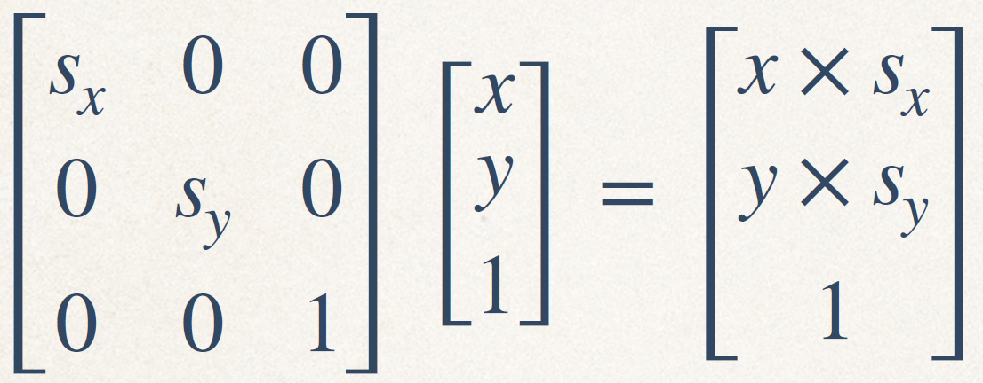
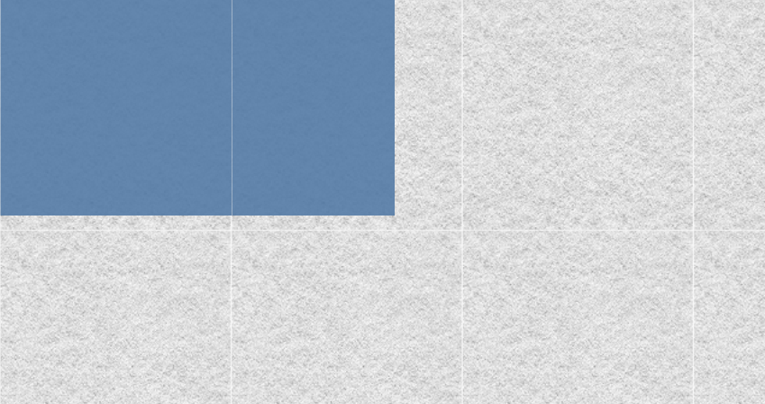
Scale
(0,0)
x
Y

Slide 21

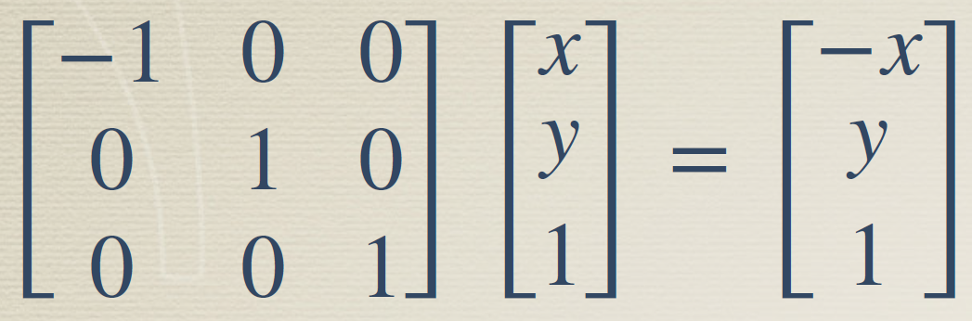
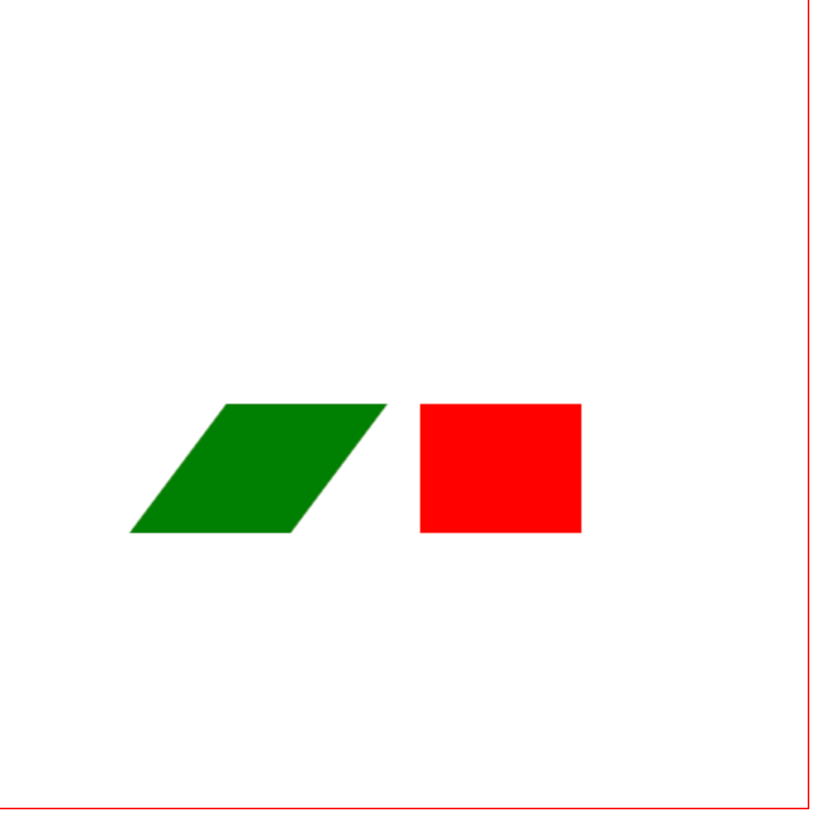
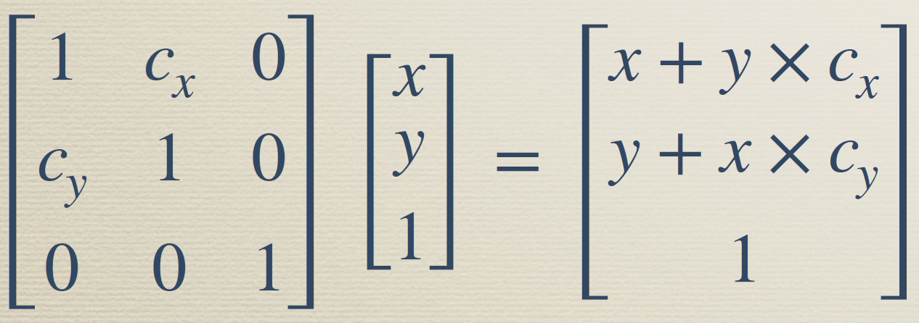
Reflection
canvas = document.getElementById("myCcanvas");
g = canvas.getContext('2d');
g.translate(100,100);
g.fillStyle="red";
g.fillRect(0,0,100,80);
g.scale(-1,1);
g.fillStyle="green";
g.fillRect(0,0,100,80);
Sheer

Slide 22
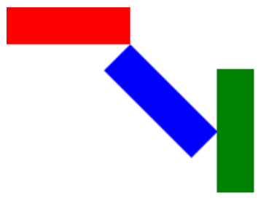

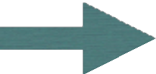
<!DOCTYPE html>
<html><head><meta charset="utf-8"></ head><body>
<!-- canvas的定義-->
<canvas id="a_canvas" width="300" height="300"></canvas>
<script type="text/javascript">
// 取得canvas var canvas =
document.getElementById("a_canvas");
// 取得⽤來描繪的上下⽂
var ctx = canvas.getContext("2d");
// 定義描繪矩形的⽅法
function drawRect(context, color) {
context.fillStyle = color;
context.fillRect(0, 0, 100, 30);
}
function rotateDeg(context, deg){
var rad = deg * Math.PI / 180;
context.rotate(rad);
}
drawRect(ctx, "red");
ctx.save(); // 儲存狀態
ctx.translate(100,30); // 平⾏移動位置
rotateDeg(ctx, 45); // 旋轉45度
drawRect(ctx, "blue");
ctx.restore(); // 復原狀態
// (3)指定移動與旋轉並描繪
ctx.save(); // 儲存狀態
ctx.translate(200,50); // 平⾏移動位置
rotateDeg(ctx, 90); // 旋轉90度
drawRect(ctx, "green");
ctx.restore(); // 復原狀態
</script>
</body></html>

Slide 23
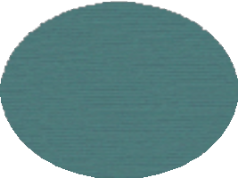

Transformation Sequence & Scene graph
Math:T₁(T₂(T₃(Shape₁)))
Matrix:T₁ × T₂ × T₃ × Shape₁
T₁
T₂
T₁ T₂ T₃
Shape₁
T₃
Shape₁

Slide 24
save() and restore() default state
Math:T₁(T₂(T₃(Shape₁)))
T
Matrix:T × T × T (Shape )
1
1
save()
T₁ T₂ T₃
Shape₁ restore()
2 3 1
T
2
T₃
Shape
1

Slide 25
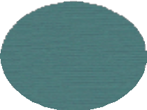

Transformation Sequence & Scene graph
T
1
T₁
save()
T₂ T
T₂
T₄
3
Shape₁
Shape
T
shape
shape
3
3
4
2
restore()
T₄
Shape₄
shape₁
shape₂

Slide 26

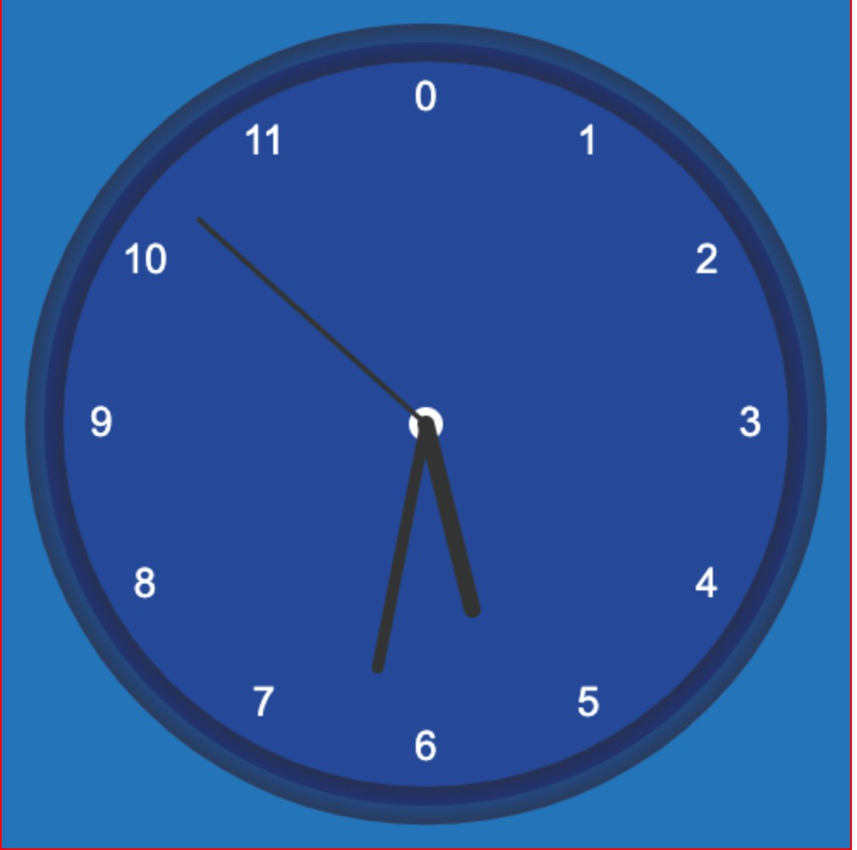
Digital Clock
var canvas;
var g;
var radius;
function init(){
canvas = document.getElementById("canvas");
g = canvas.getContext('2d');
radius = canvas.height/2*0.9;
setInterval(drawClock,1000);
}
function drawClock(){
g.save();
g.clearRect(0,0,canvas.width,canvas.height);
g.translate(canvas.width/2,canvas.height/2);
drawFace();
drawText();
drawTime();
g.restore();
}
設定drawClock呼叫間隔，每1sec重畫時間
畫clock, 儲存狀態->移到clock中心->畫出clock(drawFace, drawText, drawTime)

Slide 27
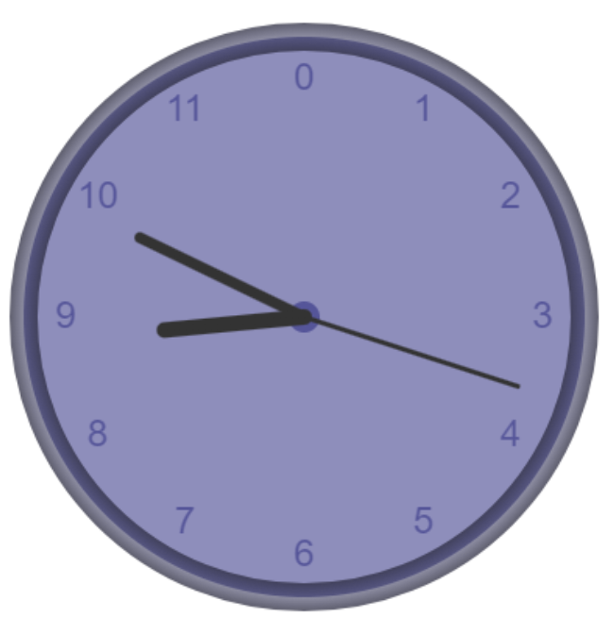
function drawFace(){
g.beginPath();
// outer cicle
g.arc(0,0,radius,0,2*Math.PI);
g.fillStyle='rgb(30,30,120,0.5)';
g.fill();
grad = g.createRadialGradient(0,0,radius*0.90, 0,0,radius*1.1);
grad.addColorStop(0, '#333');
grad.addColorStop(0.5, 'rgb(30,30,70,0.5)');
grad.addColorStop(1, '#333');
g.strokeStyle = grad;
g.lineWidth = radius * 0.1;
g.stroke();
g.beginPath();
//inner circle
g.arc(0,0,10,0,2*Math.PI);
g.fillStyle = '#ﬀf ';
g.fill();
}
畫clock的外觀

Slide 28
function drawText(){
g.font = 24 + "px arial";
g.textBaseline="middle";
g.textAlign="center";
for(i=0 ; i< 12;i++){
g.save();
g.rotate(Math.PI/6*i);
g.translate(0,-radius*0.85);
//g.rotate(-Math.PI/6*i);
g.fillText(''+i,0,0);
g.restore();
}
}
畫clock 0～11的數字，共12格，所以每格角度為PI/6
想想看：為什麼是先rotate再translate?若順序相反會發生什麼狀況？

Slide 29
function drawTime(){
var date = new Date();
seconds = date.getSeconds()*6;
minites = (date.getMinutes()+ date.getSeconds()/60)*6;
hours = (date.getHours()+(date.getMinutes()+ date.getSeconds()/60)/60) %12*30;
drawHand(seconds,radius*0.8,3);
drawHand(minites,radius*0.65,7);
drawHand(hours,radius*0.5,10);
}
function drawHand(angle,length,width){
g.save();
g.beginPath();
g.lineCap='round';
g.lineWidth=width;
g.rotate(angle*Math.PI/180);
g.moveTo(0, 0);
g.lineTo(0, -length);
g.stroke();
g.restore();
}
畫clock的秒針、分針、時針
360/60
360/60
將minites除60，轉為小時
轉12小時制，每小時30度

Slide 30
Firework
Source: Coding Fireworks

Slide 31
<html>
<body>
<canvas id="fireworks" width="500" height="500" style="border:1px solid #000000;"></canvas>
<script>
canvas = document.getElementById("fireworks");
const ctx = canvas.getContext('2d');
// firework JavaScript will go here
</script>
</body>
</html>

Slide 32
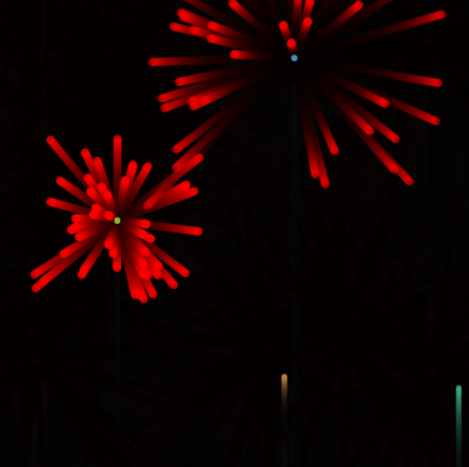
Drawing Fireworks
The Firework class will represent a single firework rocket launching into the sky
The Particle class will represent the particles that are emitted when the firework explodes

Slide 33
class Particle {
constructor(x, y, color) {
this.x = x;
this.y = y;
this.color = color;
this.vx = (Math.random() - 0.5) * 8;
this.vy = (Math.random() - 0.5) * 8;
this.alpha = 1;
this.friction = 0.99;
}
draw() {
ctx.globalAlpha = this.alpha;
ctx.beginPath();
ctx.arc(this.x, this.y, 2, 0, Math.PI * 2);
ctx.fillStyle = this.color;
ctx.fill();
}
update() {
this.vx *= this.friction;
this.vy *= this.friction;
this.x += this.vx;
this.y += this.vy;
this.alpha -= 0.01;
}
}
如果使用stroke()?
ctx.strokeStyle = "red";
ctx.stroke();

Slide 34
The Particle class is defined to represent individual particles in a firework explosion.
It has properties for its position (x, y), color, velocity, opacity (alpha), and friction.
The draw method is responsible for drawing an individual particle on the canvas. Draw particle by arc().
The update method changes the velocity and position of the particle as well as reduces its opacity, simulating the particle flying out and fading away.

Slide 35
class Firework {
constructor(x, y, color) {
this.x = x;
this.y = y;
this.color = color;
this.vx = 0;
this.vy = Math.random() * -2.5 - 0.5;
this.particles = [];
this.lifespan = 180;
this.hasExploded = false;
}
draw() {
ctx.beginPath();
ctx.arc(this.x, this.y, 3, 0, Math.PI * 2);
ctx.fillStyle = this.color;
ctx.fill();
}
explode() {
for (var i = 0; i < 50; i++) {
this.particles.push(new Particle(this.x, this.y, this.color));
}
}
update() {
this.lifespan--;
if (this.lifespan <= 0 && !this.hasExploded){
this.explode();
this.vx = 0; this.vy = 0;
this.hasExploded = true;
} else if (this.lifespan > 0) {
this.y += this.vy;
}
for (var i = 0; i < this.particles.length; i++) {
this.particles[i].update();
this.particles[i].draw();
}
}
}

Slide 36
The Firework class is defined to represent a firework rocket before and after explosion.
It has properties for its position (x, y), color, velocity, particles array (will contain instances of Particle after explosion), lifespan (how long before it explodes), and hasExploded (a flag indicating if it has exploded).
The draw method draws the firework rocket on the canvas.
The explode method creates multiple particles at the firework’s current position, simulating an explosion.
The update method updates the position of the firework or triggers the explosion when the lifespan is over. It also updates and draws particles if the firework has exploded.

Slide 37
fireworks = [];
function animate() {
ctx.fillStyle = 'rgba(0, 0, 0, 0.1)';
ctx.fillRect(0, 0, canvas.width, canvas.height);
for(var i = 0; i < fireworks.length; i++){
fireworks[i].update();
fireworks[i].draw();
if (fireworks[i].lifespan <= 0 && fireworks[i].particles[0].alpha <= 0) {
fireworks.splice(i, 1);
}
};
if (Math.random() < 0.015) {
const x = Math.random() * canvas.width;
const color = 'rgb('+Math.random()*255+','+Math.random()*255+','+Math.random()*255+')';
fireworks.push(new Firework(x, canvas.height, color));
}
requestAnimationFrame(animate);
}
animate();

Slide 38
The animate function is the core of the animation. It uses requestAnimationFrame to create a loop that updates the canvas drawing in quick succession, creating the animation effect.
Within this function, the canvas is cleared every frame to make space for the new positions of fireworks and particles.
New instances of Firework are occasionally pushed to the fireworks array to launch new rockets.
Each firework in the fireworks array is updated and drawn every frame. If the firework has exploded and all particles have faded away, it is removed from the array.

Slide 39
Add gravity force
Newton dynamics f = ma
Vectors, velocity, and acceleration:
  v(n + 1) = v(n) + a * t
  p(n + 1) = p(n) + v * t
//ex. particle update func.
update() {
this.vx *= this.friction;
this.vy *= this.friction;
this.x += this.vx;
this.y += this.vy;
this.alpha -= 0.01;
}
參考左邊公式，加入加速度

Slide 40

Homework_1(demo later with Homework_2)
Design particle eﬀects such as fireworks, particles using canvas drawing.
Particle can be any shape like circle, star, ..
Path of particles can be affected by gravity or other force
Add forest as your background like lec03_Canvas for the Nature I.pptx
Please cite the source of reference

